Slide 1
Real-time GIS
Proof of Concept Architecture, Design, and Implementation
Alex Bostic, Solutions Architect
Sponsored by the Bureau of Safety and Environmental Enforcement
JS Geo October 8th, 2015

Slide 2


What the project is about:
Situational Awareness during Storage, Transit, Deployment and Response
Response equipment, geographically separated inventory
Near real time tracking of deployed assets, resources and equipment
Assets can be gathered at a staging area for deployment during a response
Notes:
Sponsored by Bureau of Safety and Environmental Enforcement

Slide 3
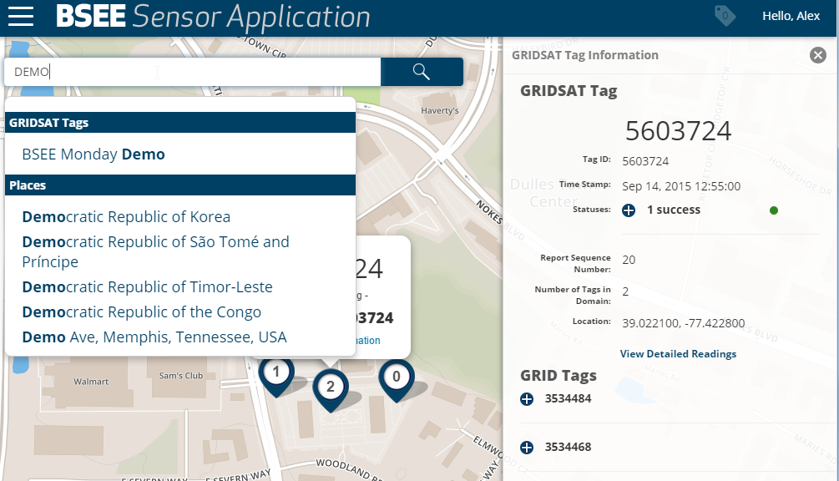

Slide 4








System Architecture:
GST Gateway
GST Parser
Web API
Stakeholders view data using map viewer (Mapping API)
Geographic Information System (GIS) Software Application Package
Internet
Satellite Gateway
Satellite Communications
Grid Satellite Tags
(GSTs)

Slide 5






Component Architecture:

Slide 6
Satellite Gateway:
Internet
2432B63637902529
Expensive
Want messages to be small
Globally Accessible
Takes in Binary/Sends out HEX
Satellite Gateway
Satellite Communications
GSTs
01001000 01100101 01101100 01101100 01101111 00100000 01001010 01010011 00100000 01000111 01100101 01101111

Slide 7
Server Gateway:
GST Gateway
Hosted on AWS
Single IP/Single Port
Receives Data as HEX
2432B63637902529
Internet
Satellite Gateway

Slide 8

Data Parsing Engine:
function getBits (ba, start, size) {
var bits [];
……..
return bits
}
Handles Bit Streams as Node Buffers
Node-BitArray lib
Satellite Definition File
More like GST definition file
Parses Data
2432B63637902529
{
"gridsat":
{
"desc":"GridSat Def",
"data":
[
{"type":"gridbegin", "size":10, "desc":"Grid Begin", "name":"gridbegin"},
{"type":"gridblank", "size":41, "desc":"Grid Blank Test", "name":"gridblank"},
{"type":"byte", "size":1, "desc":"Message Type", "name":"messagetype"},
{"type":"byte", "size":2, "desc":"Message Length", "name":"messagelength"},
Notes:
Parses Data
Loops through definition file
Converts bits to binary
Creates a new Mongo doc
Saves Mongo Doc

Slide 9
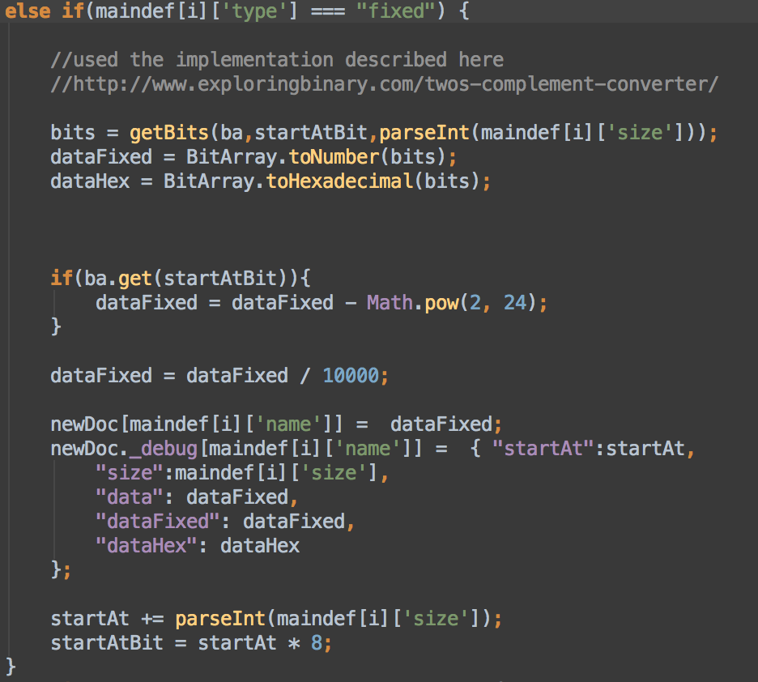
Data Parsing Engine (lat/lon):

Slide 10


Solr:
Super-fast, lightweight search engine
Based on Lucene (Indexing)
Indexes data as it is added or edited
Web API:
RESTful
Node and Express
Returns JSON/GeoJSON
Turf

Slide 11
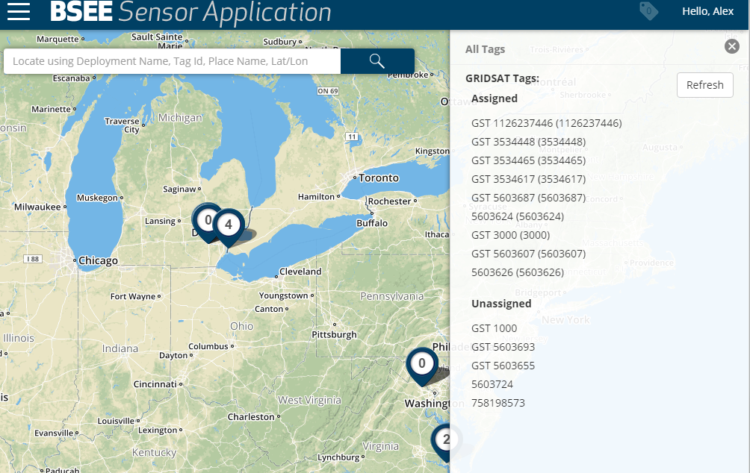
Client App:
Displays GSTs
Provides Search
Manage Deployments
Manage GSTs

Slide 12










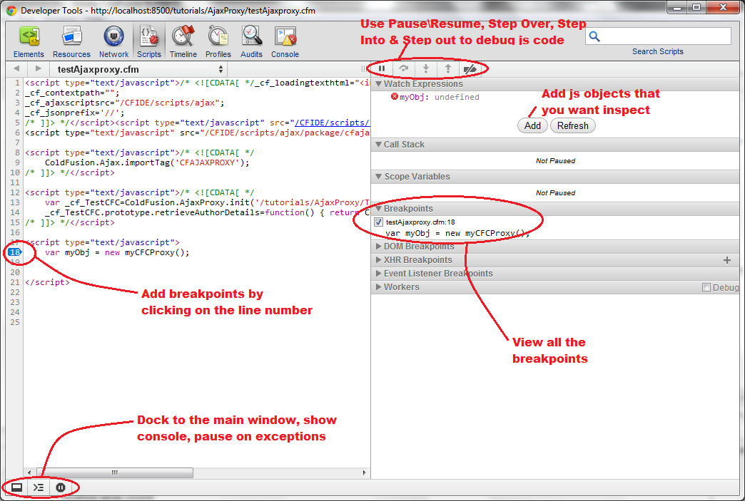


Dev Stack:
Notes:
Git
Node
Bower
-----------
Web Storm
HTLM 5/CSS3/Javascript
LESS
----------
Gulp
Karma + Jasmine
Protractor
Mocha
------------------------
Jenkins
NGINX
Sauce Labs
Chrome Debugger

Slide 13

What’s Next:
More Spatial Search
Pushing to Client
Client Polling
Socket io
Pusher/Firebase/Others
Better Browser and Mobile Support
Clustering
Index Mongo with Solr
Switch to PostGIS????

Slide 14
Questions
Alex Bostic, Solutions Architect
AECOM
@habostic
JS Geo October 8th, 2015

